Slide 2
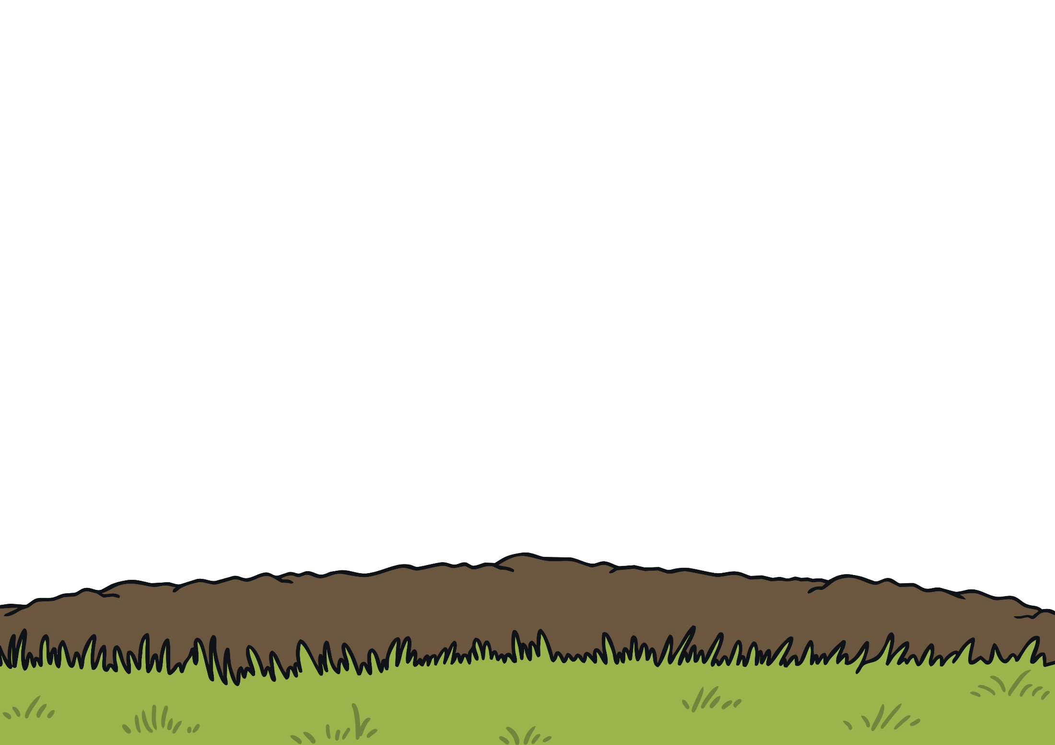

Helping Rosie
Rosie loves her garden. She has planted lots of lovely seeds in the garden and waters them every day.
She is waiting for the flowers to grow.

Slide 3



Rosie has forgotten how many seeds she has planted.
When the flowers grow, can you help her by counting the flowers and finding the number that matches.
Remember, the flowers will only grow when they are watered. Have a try here.

Slide 4



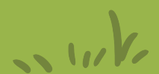
Helping Rosie
Can you count the flowers and click on that number?
Well done! There are 3 flowers.
0
1
2
3
4
5

Slide 5


Rosie has more seeds to water here.
Can you count the flowers and click on that number?
Super! There are 5 flowers.
0
2
5
4
3
1

Slide 6
There are still some seeds to water.
Can you count the flowers and click on that number?
Well done! There is only 1 flower growing here.
1
3
2
5
4
0

Slide 7
Keep watering!
Can you count the flowers and click on that number?
You are great gardeners! There are 4 lovely flowers here.
5
3
2
4
1
0

Slide 8
You are almost there!
Can you count the flowers and click on that number?
Oh dear! What has happened here? There are no flowers. That means there are 0.
0
5
2
4
1
3

Slide 9






Look at Rosie’s beautiful garden!
Wow! Rosie’s garden looks amazing. She has grown so many lovely flowers. She has put some in pots to give to her friends. Can you count the flowers in the pots and check the number is correct?
2
0
4
5
1
3

